Slide 1

DEPARTMENT OF CSE-AIML (CSM) – IV-II Sem
Project Review - 1
Project Title : AI - Powered Smart Trip Planner
        Team
1.N.Srujana - 21BQ1A4C1
2. K.Praneeth - 21BQ1A4295
3.J.Yeshwanth - 21BQ1A42C5
4. Ch.Kamal Vardhan - 21BQ1A4271
Project Guide: K.Gnanendra
Associate Professor,
Dept.of CSM,
VVIT

Slide 2

DEPARTMENT OF CSE-AIML (CSM) – IV-II Sem
Project Review - 0
Project Title : AI - Powered Smart Trip Planner
Project Description:
The "AI-Powered Smart Trip Planner" is a comprehensive travel solution that integrates advanced AI, Machine Learning, and Natural Language Processing to enhance the tourist experience. It provides personalized travel planning, optimized itineraries, and time safety alerts. User Authentication offers a secure and seamless login process, enablingpersonalized recommendations based on travel history. The AI-Powered Virtual TravelAssistant offers tailored suggestions, answers travel queries, and helps users plan trips efficiently. Dynamic Pricing Optimization for Hotels monitors prices in real-time,recommending the best times to book within budget. Real-Time Travel Safety and Health Advisory delivers instant notifications on safety and health conditions at travel destinations.Tourist Behavior Prediction uses machine learning to predict user preferences and suggest activities and routes based on similar traveler behavior, while Tourism Sentiment Analysis assesses social media and reviews to guide informed decisions. The Smart Travel Companion for Sustainable Tourism promotes eco-friendly options, and the Acting as a Tourist Guide feature offers real-time insights about landmarks. Additionally, the Budget-Based Destination Finder recommends cities or states based on budget constraints, and the Emergency Hospital Locator helps tourists find nearby medical services in case of an emergency. This all-in-one solution ensures a smooth, safe, and efficient travel experience.

Slide 3
DEPARTMENT OF CSE-AIML (CSM) – III-I Sem
E2E Project Review - 1
Project Title
Project Functional Requirements: (Features):
* Secure User Authentication
* AI-Powered Virtual Travel Assistant
* Dynamic Pricing Optimization for Hotels
* Real-Time Travel and Health Safety Advisory
* Tourist Behavior Prediction
* Sentiment Analysis for Destinations
* Sustainable Travel Options
* Emergency Hospital Locator
10/2/2023

Slide 4
DEPARTMENT OF CSE-AIML (CSM) – IV-II Sem
Project Review - 0
Project Title : AI - Powered Smart Trip Planner
Project Title : AI - Powered Smart Trip Planner
10/2/2023

Slide 5
DEPARTMENT OF CSE-AIML (CSM) – III-I Sem
E2E Project Review - 1
10/2/2023

Slide 6
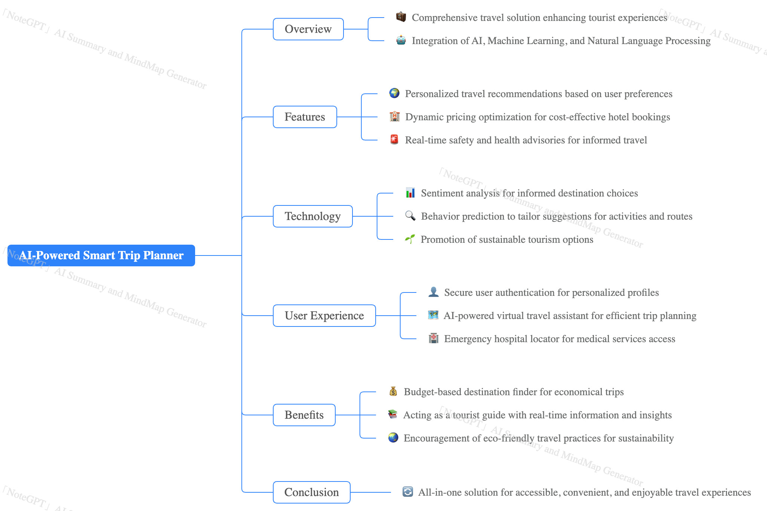
DEPARTMENT OF CSE-AIML (CSM) – III-II Sem
E2E Project Review - 1
Project Title
10/2/2023

